Slide 1


Motorverse A Project by MonoSys
Owned By : Qusai Mansoor 22i-0935 Ahmad 22i-1288 Ahmad Ali 22i-0825

Slide 2
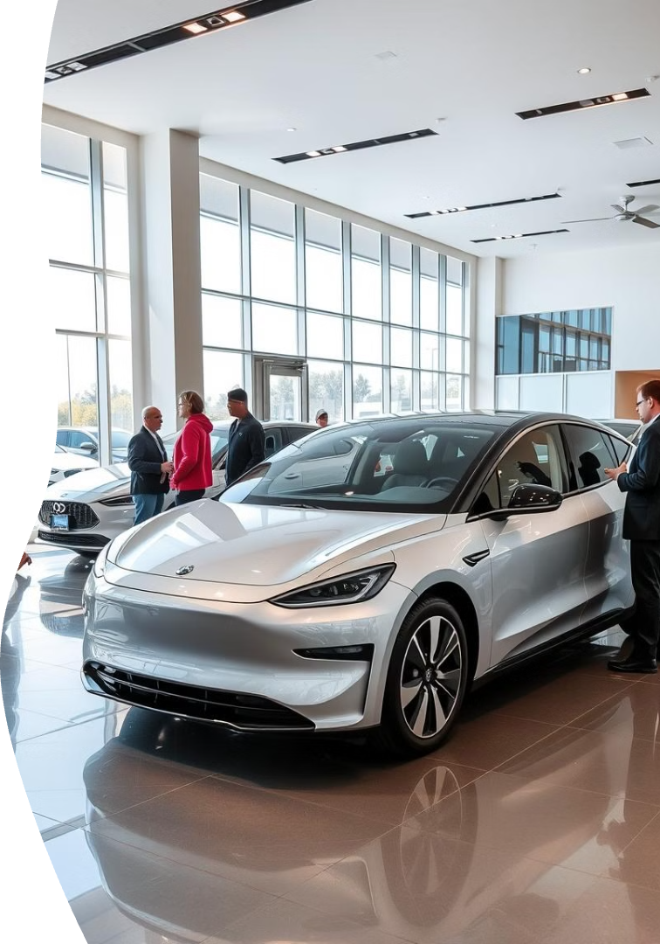
Welcome to Motorverse
Welcome to Motoverse, where your automotive journey begins and ends with convenience, trust, and innovation.
Revolutionizing the Automotive Marketplace with Integrated Sales, Rentals, and Services
First of a kind platform that combines Car purchase, rentals and auto parts purchase in a single application, thereby providing a seamless and one stop solution to all car related problems.

Slide 3
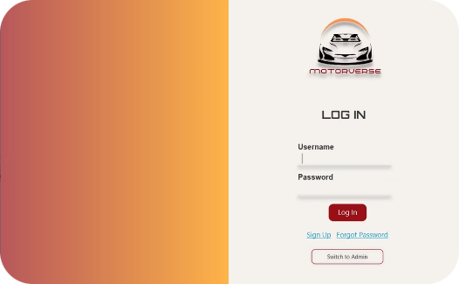
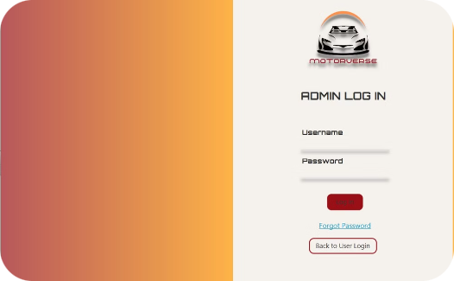
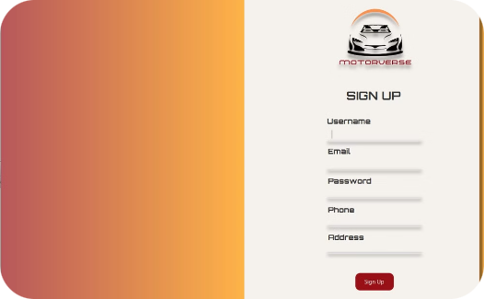
User and Admin Interfaces
User Login
Admin Login
User Sign Up
Registered User can Login to their account and enjoy the Ultimate Car Marketplace Experience.
Dedicated admin login for managing the Motorverse platform, inventory, and customer data.
Simple and straightforward sign up process for new users to join the Motorverse community.

Slide 4
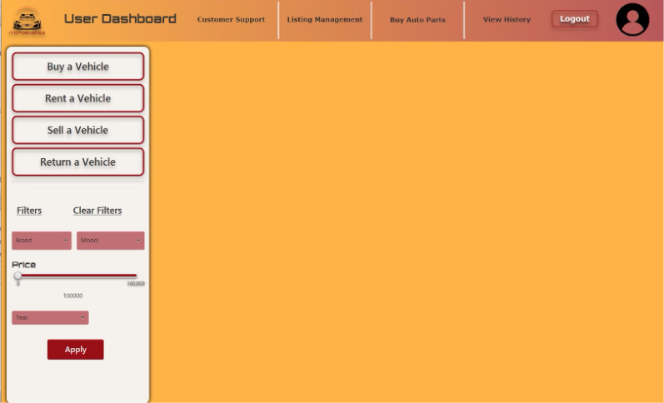
User Dashboard
The User Dashboard is the central hub of the Motorverse platform, providing registered users with a personalized and seamless experience. Here, users can manage their account details, view their purchase history, and access a wide range of automotive resources and services.
Services :
Buy Vehicle
Rent Vehicle
Sell Vehicle
Return Rented Vehicle

Slide 5
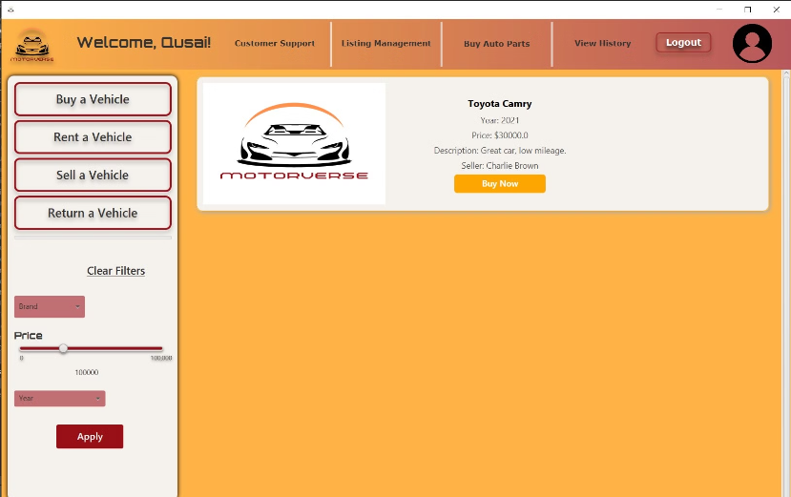
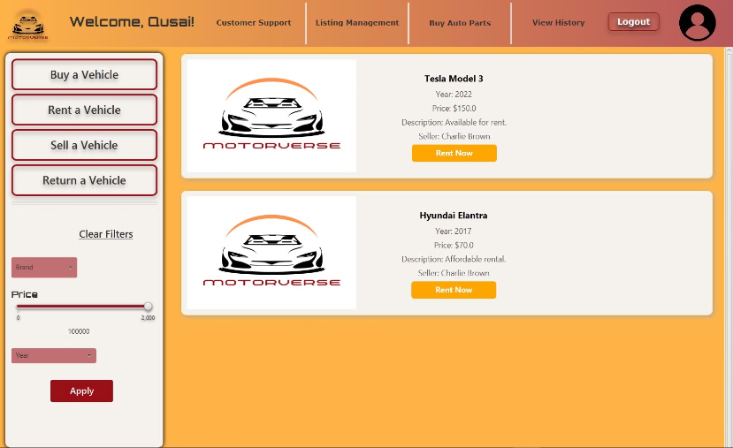
Buying and Renting Interfaces
Buying Interface
The Motorverse buying interface allows users to seamlessly search, browse, and purchase vehicles from a comprehensive inventory.
Intuitive filters, detailed vehicle information, and secure payment options create a friction-free buying experience. Note : Only Vehicles available for buying would be available
Renting Interface
For users interested in temporary vehicle access, the Motorverse renting interface offers a convenient and flexible solution.
Renters can easily search available vehicles, view rental rates, and complete the rental process through a streamlined digital experience.
Note : Only Vehicles available for renting would be available

Slide 6
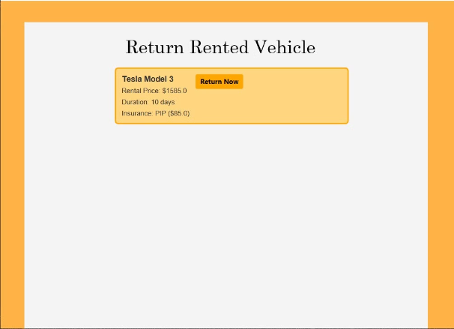
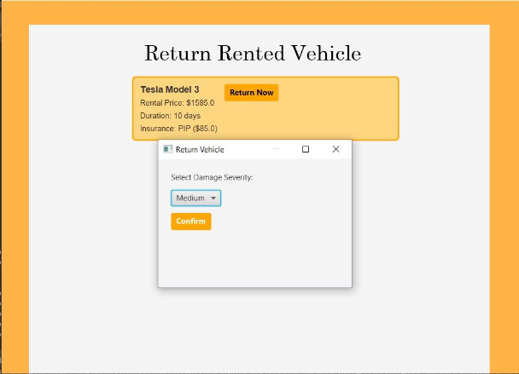
Return Rented Vehicle Interface
Hassle-Free Vehicle Returns
The Motorverse return interface simplifies the process of ending a vehicle rental. Renters can conveniently return the vehicle, review final charges, and complete the transaction through a user-friendly digital experience.
Damage Calculation
The Renter will be charged damages cost relative to the cars complete worth.

Slide 7
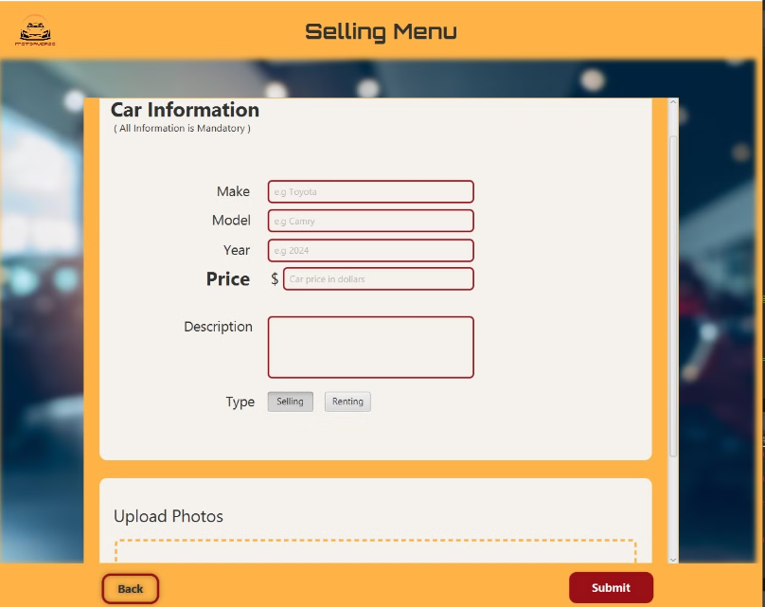
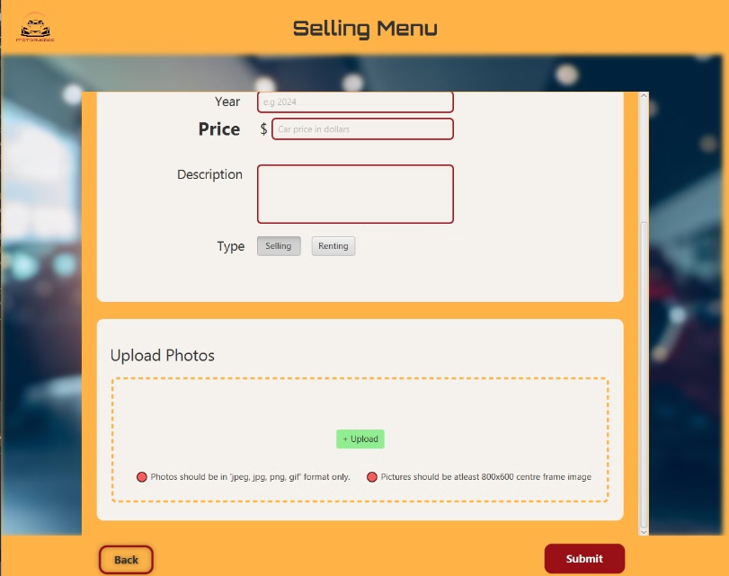
Motorverse Selling Interface
Listing Vehicles
Showcasing Vehicles
The Motorverse selling interface provides users to seamlessly list their vehicles for sale. With a focus on simplicity and transparency, the interface guides sellers through a user-friendly process to showcase their cars, set pricing.
User can add their customised images of their vehicle.

Slide 8
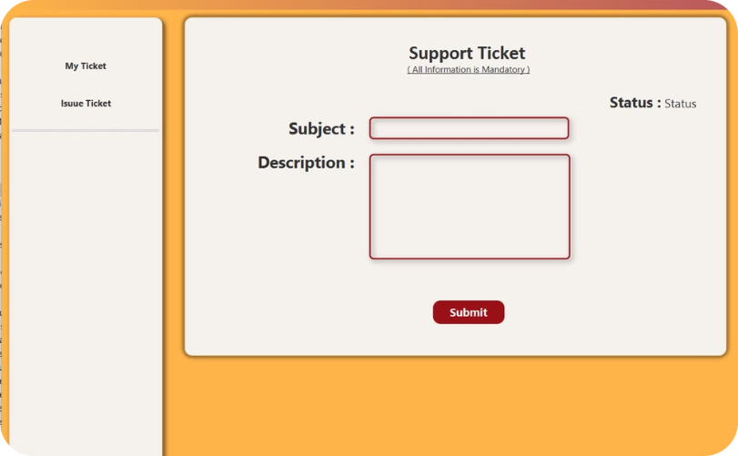
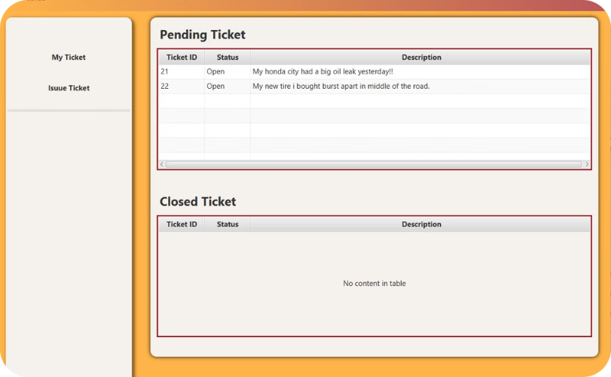
Customer Support Interface
Support Ticket Issuing
Streamlined Assistance
Users can issue a new Ticket to resolve their relevant problem and concerns.
Users can monitor their Pending Tickets and their Resolved Tickets for their problems and concerns.

Slide 9
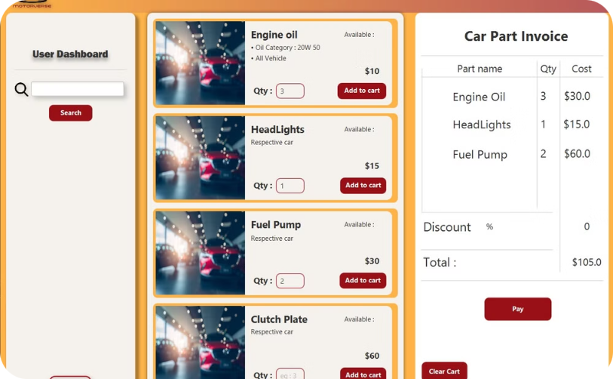
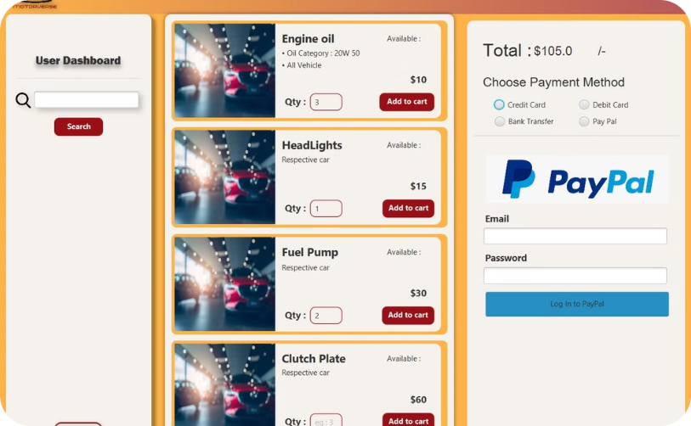
Auto Parts Interface with Payment Menu
Streamlined Auto Parts Ordering
Flexible Payment Options
The Motorverse auto parts interface allows users to easily search, select, and purchase replacement parts for their vehicles. Integrated payment options ensure a seamless checkout experience.
Users can conveniently pay for their auto parts purchases using a variety of payment methods, including credit/debit cards and digital wallets, directly within the interface.

Slide 10

Buying Vehicle
(A Major and Complex Use Case)

Slide 11
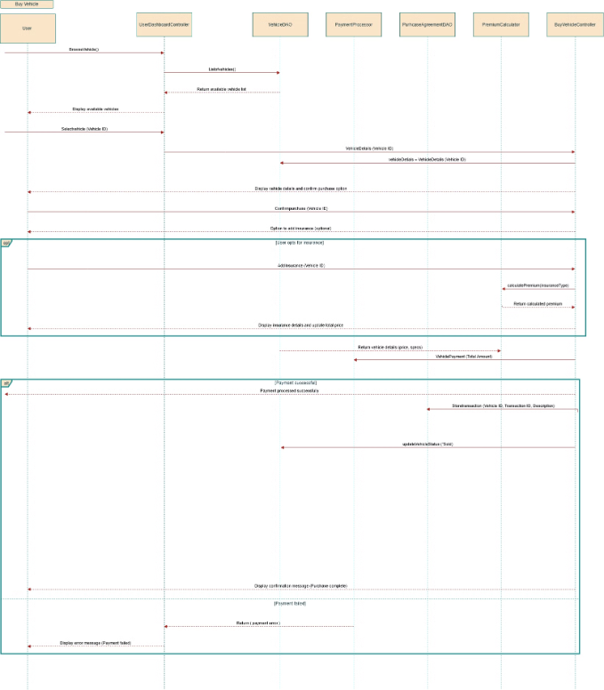
Buy Vehicle Use Case Sequence Diagram

Slide 12
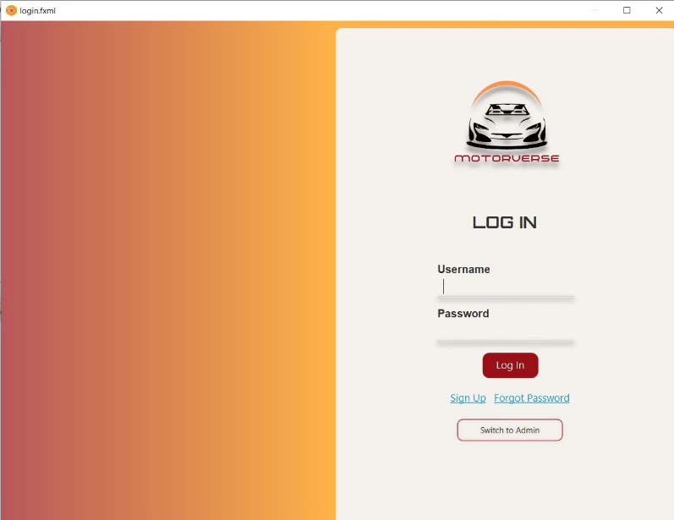
User Login Interface
The user will login by adding credentials

Slide 13
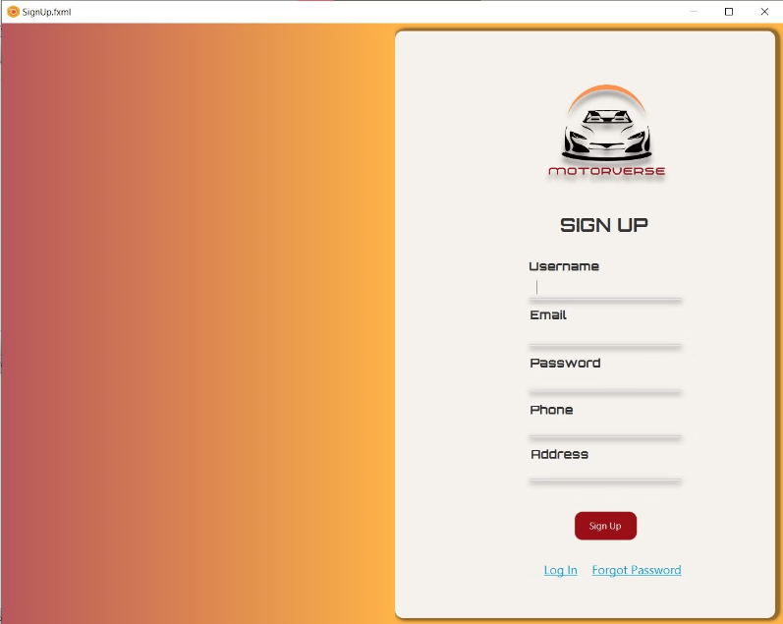
Sign UP Interface
The user can Register if the user doesn't have an account

Slide 14
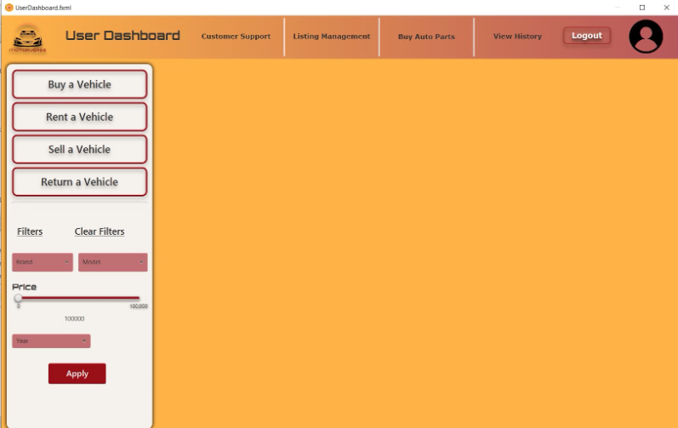
User Dashboard
User have multiple options like
Buy a vehicle
Rent a Vehicle
Sell a Vehicle
Return a Vehicle
Can manage it's Profile

Slide 15
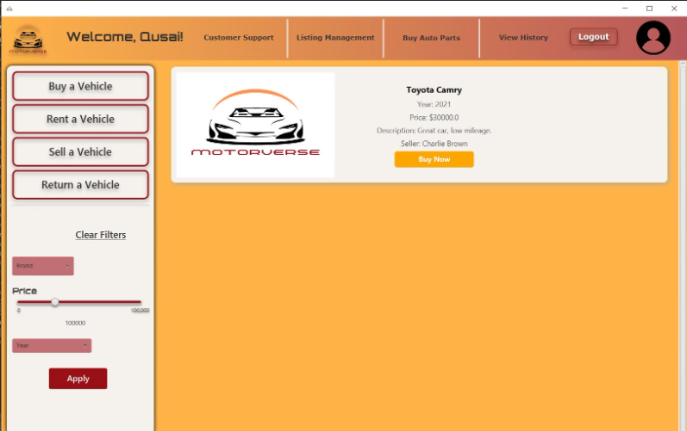
Buy a Vehicle
Upon clicking Buy a Vehicle option, cars will be shown
Users can filter the cars based on Brand, Price, and Year

Slide 16
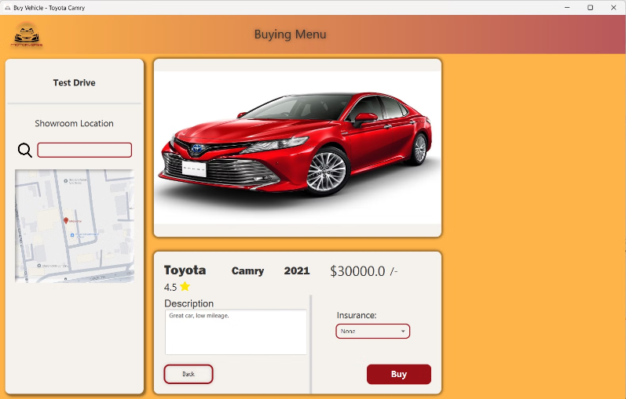
Selected a Car
When user selects the car, all the car details will be shown
User will be able to add Insurance and Test Drive for that Car

Slide 17
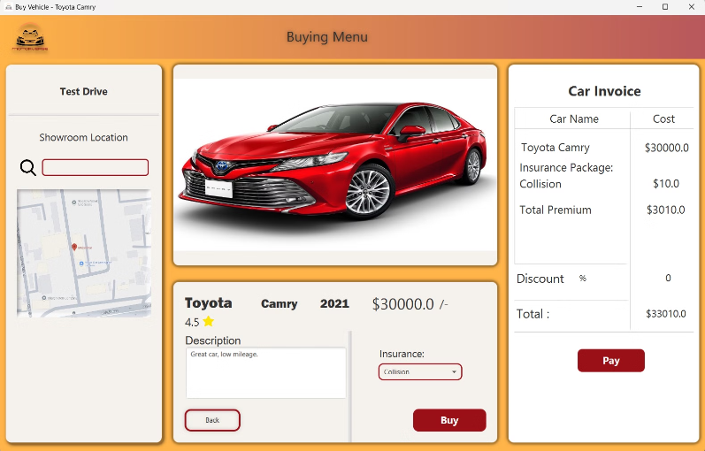
Car Invoice
By clicking on Buy, Car invoice will be generated which includes the car price and insurance payment both.
User would be able to pay the invoice by clicking pay button

Slide 18
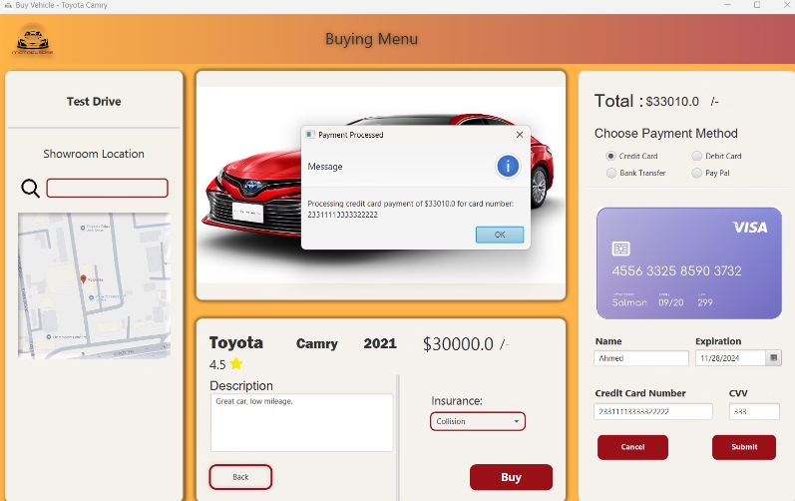
Credit Card Payment
The user will provide all the details of the credit card and proceed with the payment

Slide 19
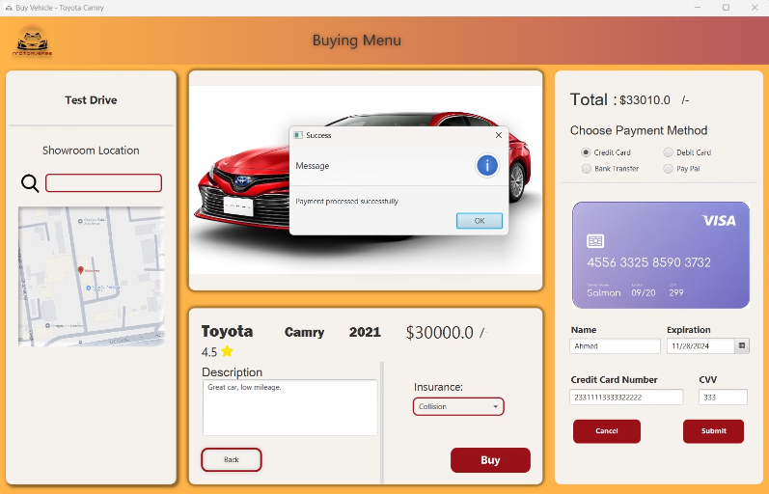
Payment Successful
Payment Successful message is show to the user upon payment completion

Slide 20
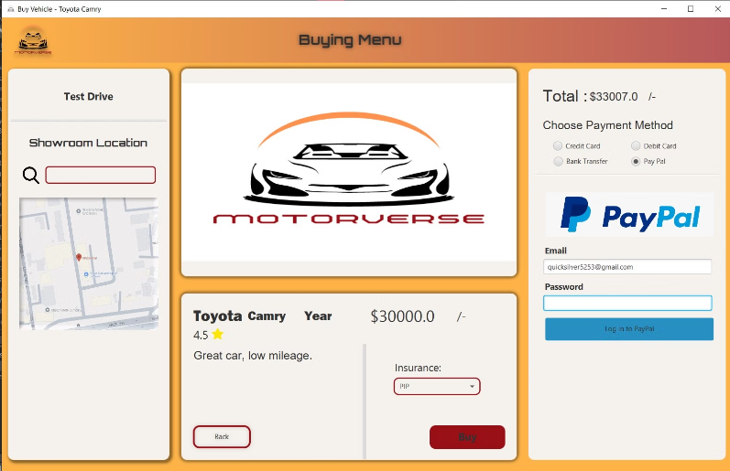
Payment Through PayPal
Users can also pay through PayPal by providing their email and password

Slide 21
Design Patterns:
1) MVC architecture
2) Strategy Pattern (In Payment handling)
3) Singleton Pattern (In session manager)

Slide 22
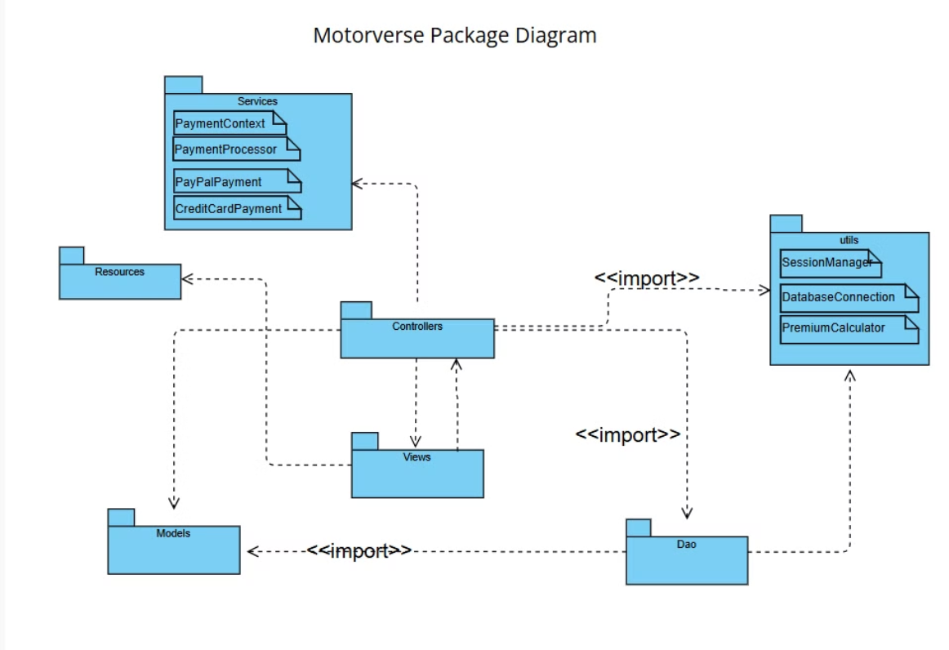
Package Diagram:

Slide 23
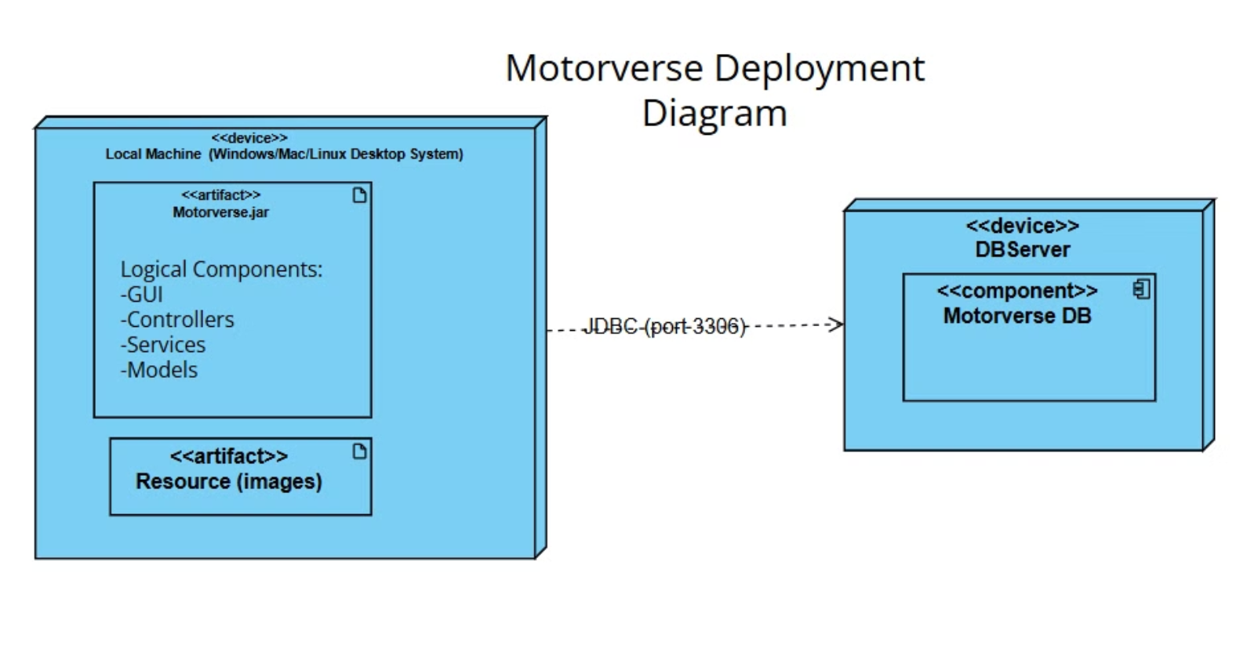
Deployment Diagram:

Slide 24
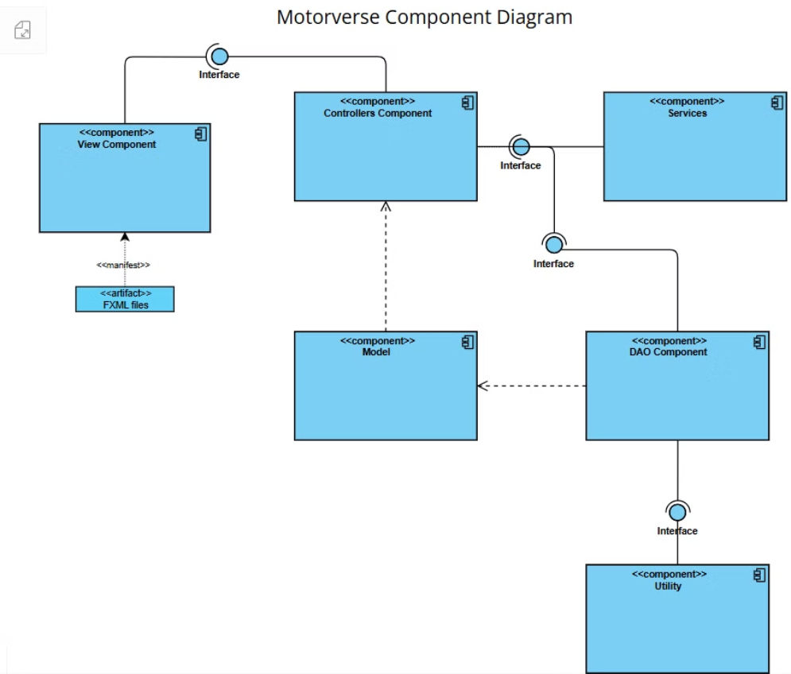
Component Diagram:

